Slide 1
State–of-Art: Software Comprehension
Edgar David Sandoval Giraldo

Slide 2
Recovering High-Level Views of Object-Oriented Applications from Static and Dynamic Information

Slide 3
HighLights
Introduces “Dynamic Information” Concept.
Reverse Enginering aproach from object oriented applications.
Uses graph representations for different views that defines a programming aspect.
Define static an dynamic relations beetween code elements.
Execution of the concepts over Moose tool and SmallTalk VM.
Uses an ETL procces for gathering info.

Slide 4
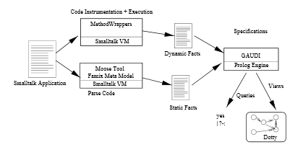
View Creation

Slide 5
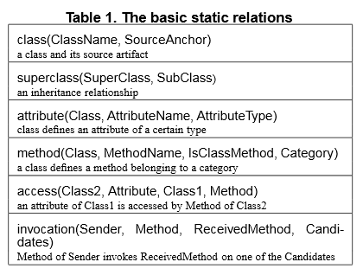
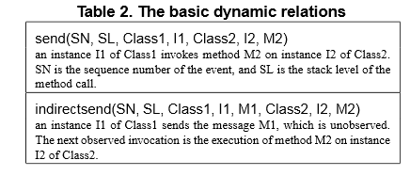
Relations

Slide 6
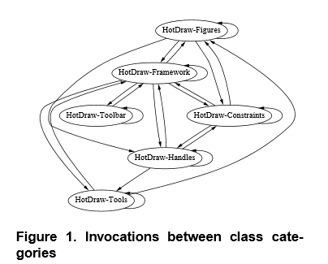
High Level View

Slide 7
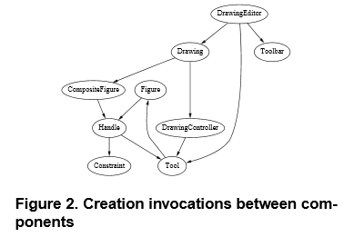
Create Invocations

Slide 8
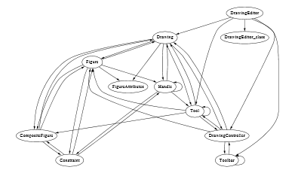
Instance Between Components

Slide 9
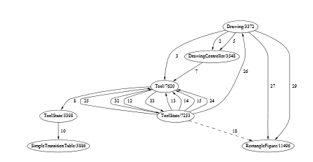
Instance Creation Inside a Component

Slide 10
Conclusions
There are levels of abstraction for any application.
Code info is not enough source of information.
The best way of representing raw info is on a graph.
Dynamic Information defines a lot of hidden aspects which normal Reenginering tools can’t show.

Slide 11
Documenting Software Systems with Views (I – VI)

Slide 12
HighLights
Complete Workaround on Views for software understanding, using a reverse enginering propietary tool (Rigi).
Emphatises on large-scale legacy systems (> 100 KLOC).
Multiple Audiences for systems.
Examining a system is not only on the source code.
An aproach for an standard Documenting process for all systems.

Slide 13
HighLights (2)
Task Oriented Clasifications: Static Graphs, Interactive Graphs and Editable Graphs.
IV part describes a metamodel (UWAT+) used for building web transaction views.
UWAT+ has 3 model parts: Organization, Execution and Navigation.
Introduce design patterns and subsystem Concepts.
Proposes 2 concepts of grouping: a Top-Down descomposition of a system into functional assemblies, using the coments on the code and a Botton-Up Chunking of classes, searching for small design patterns on the code.

Slide 14
HighLights (3)
Gives some problems related to the documentation via design patterns:
Lack of automated pattern identification.
Incapplicability.
Limited pattern vocabulary.
Class participation is not equivalence relation.
Explains a series of ways to represent design patterns in explicating designs:
Use canonical representations.
Participants in their locations.
Semi- Automatized documetnation.
Readable UML diagrams.

Slide 15
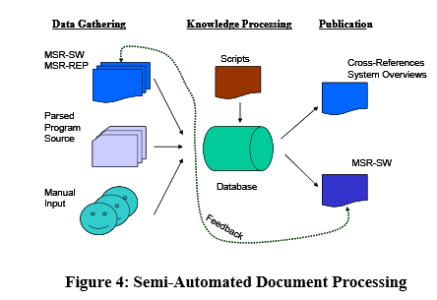
Semi- Automated Document Data Gathering

Slide 16
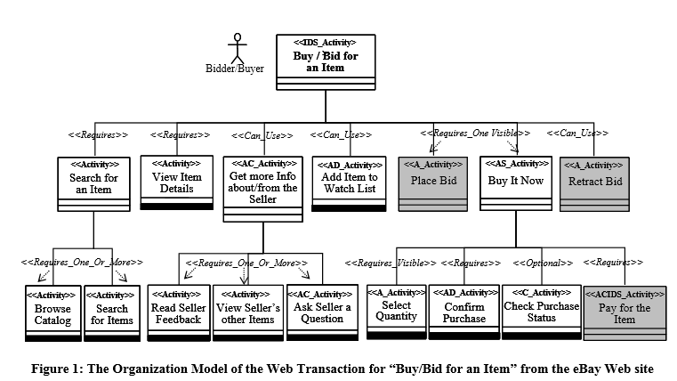
Web Organization Model

Slide 17
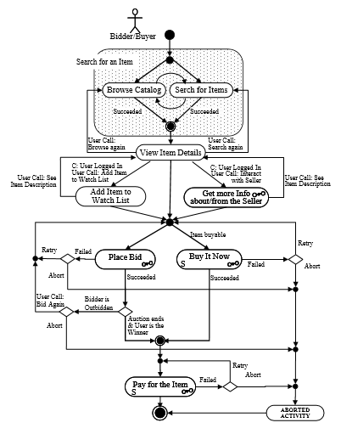
Execution Model

Slide 18
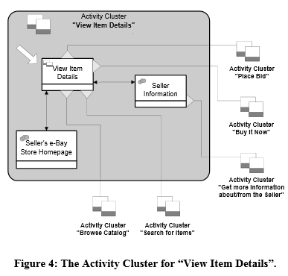
Navigation Model

Slide 19
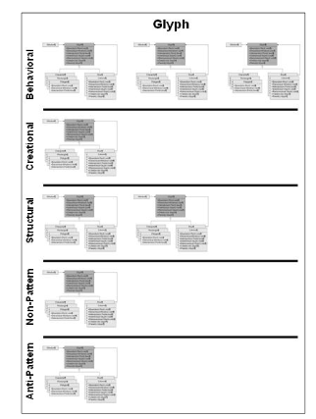
Multiple Patterns Model.

Slide 20
Conclusions
There are many aspects to take on account for analisis.
Grouping is not only inherent to code elements.
A good practice for view design is to separate aspects as much as you can. Simple read, target to the audience.
Its necesary to use canonical symbols, aiming for a better understanding.
Grouping elements on a system is not always an easy task and sometimes it can’t be automatized.

